Slide 1
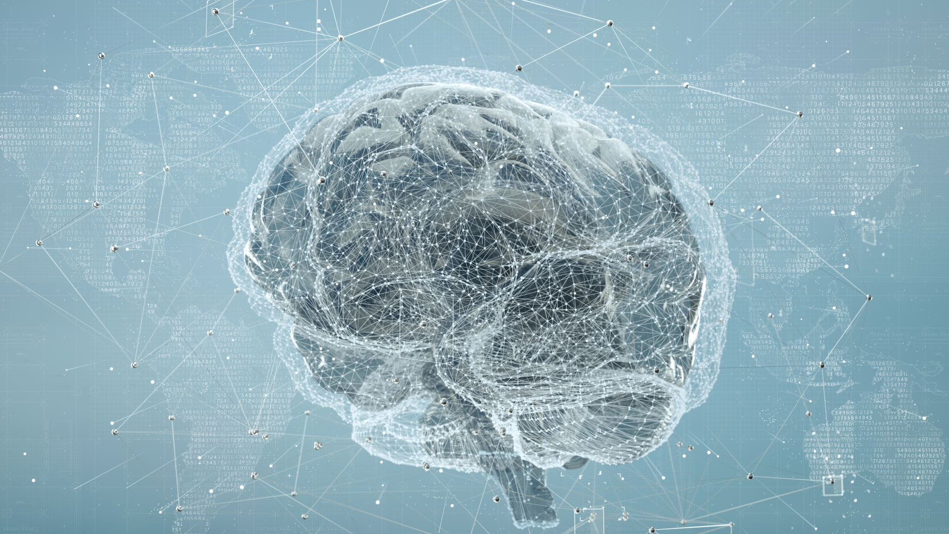
Artificial Intelligence
Natural Language Processing

Slide 2

What is Natural Language Processing?
NLP involves the development of algorithms and computational models that enable computers to understand, interpret, and generate human language.

Slide 3

Key Tasks in Natural Language Processing

Slide 4

Text Parsing
Breaking down sentences into grammatical components.

Slide 5

Named Entity Recognition
Identifying entities (e.g., names, locations) in text.

Slide 6

Sentiment Analysis
Determining the sentiment or emotion expressed in a piece of text.

Slide 7

Machine Translation
Translating text from one language to another.

Slide 8

Text Summarization
Generating concise summaries of longer texts.

Slide 9

Speech Recognition
Converting spoken language into written text.

Slide 10

Question Answering
Systems that can answer questions posed in natural language.

Slide 11

Applications of NLP

Slide 12

Chatbots and Virtual Assistants
Providing human-like interaction in customer service.

Slide 13

Search Engines
Improving search results based on natural language queries.

Slide 14

Sentiment Analysis in Social Media
Analyzing public opinion on various topics.

Slide 15
Language Translation Services
Enhancing machine translation systems.

Slide 16

Healthcare
Extracting information from medical texts and assisting in diagnosis.

Slide 17

Examples of Natural Language Processing

Slide 18

Sentiment Analysis in Social Media
NLP is employed to analyze the sentiment expressed in social media posts, comments, and reviews. Companies use sentiment analysis to understand customer opinions and feedback.
Example: Analyzing Twitter posts to determine the sentiment (positive, negative, or neutral) about a particular product or event.

Slide 19

Chatbots and Virtual Assistants
NLP powers chatbots and virtual assistants, allowing them to understand and respond to user queries in natural language. These applications use techniques like intent recognition and entity extraction.
Example: Interacting with a customer support chatbot on a website to get information or assistance.

Slide 20

Named Entity Recognition (NER) in Text
NLP algorithms can identify and classify entities such as names of people, locations, organizations, and more in a given text.
Example: Extracting names of people and locations from a news article automatically.

Slide 21

Machine Translation
NLP is used in machine translation systems to automatically translate text from one language to another.
Example: Using Google Translate to translate a paragraph from English to Spanish.

Slide 22

Text Summarization
NLP techniques can be applied to automatically generate concise summaries of longer texts, making it easier for users to grasp the main points.
Example: Summarizing a lengthy research paper to extract key findings.

Slide 23

Speech Recognition
NLP enables systems to convert spoken language into written text. This is used in applications like voice assistants and transcription services.
Example: Using voice commands to control a smart home device like a virtual assistant.

Slide 24
Question Answering Systems
NLP is employed in question answering systems that can understand user queries and provide relevant answers from a given dataset or knowledge base.
Example: Asking a virtual assistant a question like "What is the capital of France?" and receiving a spoken or written response.

Slide 25

Text Classification
NLP can categorize text into predefined classes or categories. This is useful in tasks like spam detection, sentiment analysis, and content categorization.
Example: Automatically classifying emails as spam or non-spam based on their content.

Slide 26

Healthcare Applications
NLP is used in healthcare to analyze clinical notes, extract information from medical records, and assist in diagnosing and predicting diseases.
Example: Extracting relevant information from electronic health records to support clinical decision-making.

